Slide 1

Exploratory Data Analysis of Global Covid 19 Data
By
Name: Salisu Ibrahim
Data: 30/September/2022

Slide 2
Table of the Content
Objectives of the Analysis
About the Data
Methodology
Result and Insights
Conclusions

Slide 3
Objective of the Analysis
To Identify the trend and distribution of global covid 19 cases, death and recovery of the affected country with respect to the populations, by Identify the country with highest number of cases and death.

Slide 4
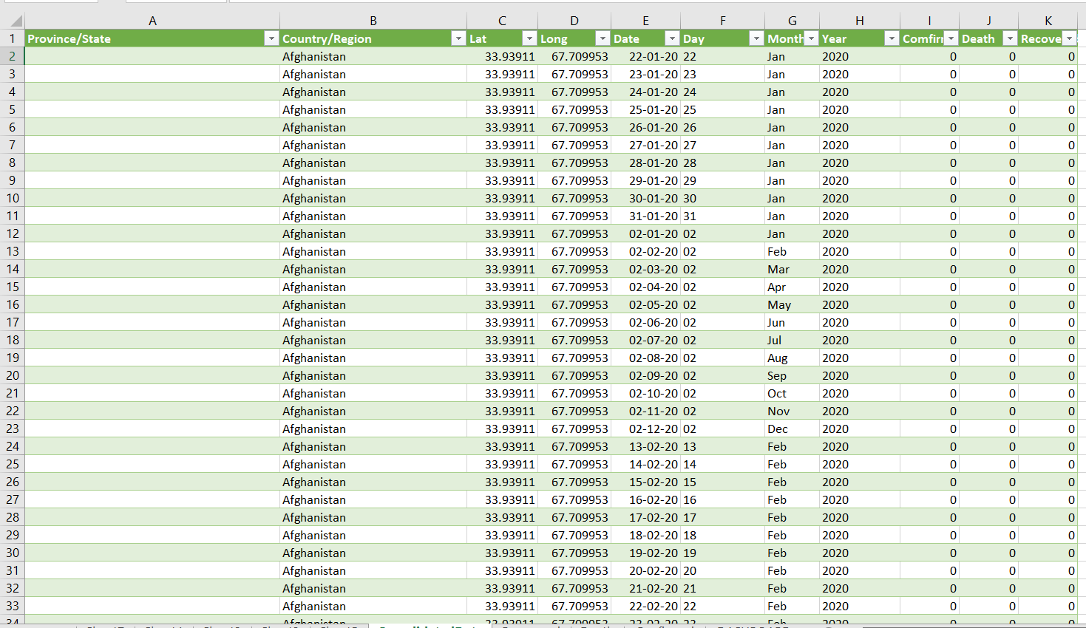
About the Data
The data is a time series data, that is it regularly updated
The source of the data is Hopkin University, United state of America
The Dataset used contains confirmed cases, Death and Recovered for countries from 2020-2022

Slide 5
Methodology
The Analysis was carried out using Microsoft Excel
The raw Dataset were cleaned and merged using power query
I used pivot table to perform calculations
And also Used Column bar chart and line Chart for data visualization

Slide 6
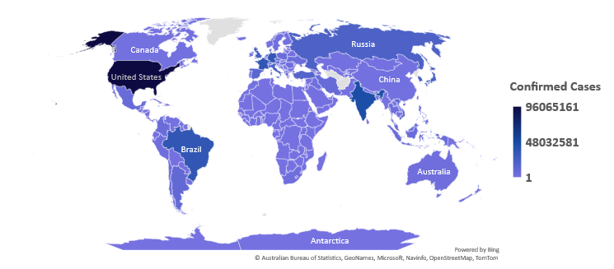
Confirmed Cases
North America, South America, Europe and Asia have the Highest number of confirmed cases
Africa has the lowest number of confirmed cases compared to other continents
The total number of cases as the analysis made is 602,796,643

Slide 7
Confirmed Cases by Year
The number of confirmed cases continue to increase every year.
There was a 144% increase in confirmed cases in 2020-2021 and 55.4% increase from 2021-2022.

Slide 8
Top 5 Countries with Confirmed Cases
The United State of America has the Highest number of cases in the world, accounting for 16% of the total cases in the world
US is followed by India, Germany, France and Brazil to round up the top 5 countries with highest number of cases
The 5 countries account for 40.2% of the global cases

Slide 9
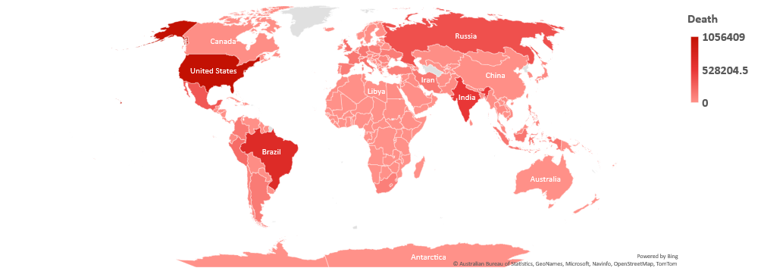
Death
North America, South America, Europe and Asia have high number of confirmed cases.
Africa has the lowest number of deaths compared to other continents
The total number of deaths cases as at the time of the analysis was made is 6,487,401.

Slide 10
Death Cases by Year
The number of Deaths increased from 2020-2021 but there has been a decline in 2022
There was 87% increase in Death from 2020-2021 and 17.3% decrease in Death from 2021-2022

Slide 11
Death Rate
Here the number of Death cases increased from 2020-2021, there was a decrease in the Death rate from 2.27 to 1.75%
The decline continued in 2022, dropping to 0.93%
The increased vaccination drive could be a drive for this however, there is not enough data to back the claim.

Slide 12
Top 5 Countries with Highest Death
The United State of America has the highest number of death cases in the world, accounting for 12.6% of the total cases in the world
US is followed by Brazil, India, Russia and Mexico to round up the top 5 countries.
The 5 countries account for 35.6% of the global cases.

Slide 13
Conclusion
From the analysis show that Covid19 is still much around as the number of cases keep increasing
There should be a continued vaccination drive to protect people from the virus
People should be more careful and observe Covid19 precautionary measures

